Slide 1
Workshop On 𝐖𝐡𝐲 𝐎𝐎𝐏 𝐢𝐧𝐬𝐭𝐞𝐚𝐝 𝐨𝐟 𝐏𝐫𝐨𝐜𝐞𝐝𝐮𝐫𝐚𝐥 𝐏𝐫𝐨𝐠𝐫𝐚𝐦𝐦𝐢𝐧𝐠
What will You Learn From this Workshop:
𝟏. 𝐍𝐞𝐞𝐝𝐬 𝐨𝐟 𝐑𝐞𝐮𝐬𝐚𝐛𝐥𝐞 𝐂𝐨𝐝𝐞 𝟐. 𝐇𝐨𝐰 𝐭𝐨 𝐑𝐞𝐟𝐚𝐜𝐭𝐨𝐫 𝐚𝐧 𝐄𝐱𝐢𝐬𝐭𝐢𝐧𝐠 𝐂𝐨𝐝𝐞 𝟑. 𝐆𝐨𝐨𝐝 𝐏𝐫𝐚𝐜𝐭𝐢𝐜𝐞 𝐚𝐧𝐝 𝐂𝐨𝐝𝐢𝐧𝐠 𝐂𝐨𝐧𝐯𝐞𝐧𝐭𝐢𝐨𝐧 𝟒. 𝐖𝐡𝐲 𝐭𝐨 𝐀𝐩𝐩𝐥𝐲 𝐎𝐛𝐣𝐞𝐜𝐭 𝐎𝐫𝐢𝐞𝐧𝐭𝐞𝐝 𝐏𝐫𝐨𝐠𝐫𝐚𝐦𝐦𝐢𝐧𝐠 (𝐎𝐎𝐏) 𝟓. 𝐄𝐱𝐩𝐥𝐚𝐢𝐧 𝐚𝐥𝐥 𝐨𝐟 𝐭𝐡𝐞𝐬𝐞 𝐖𝐢𝐭𝐡 𝐚𝐧 𝐫𝐞𝐚𝐥 𝐥𝐢𝐟𝐞 𝐞𝐱𝐚𝐦𝐩𝐥𝐞 𝐚𝐧𝐝 𝐁𝐮𝐢𝐥𝐝𝐢𝐧𝐠 𝐚𝐧 𝐀𝐩𝐩𝐥𝐢𝐜𝐚𝐭𝐢𝐨𝐧

Slide 2
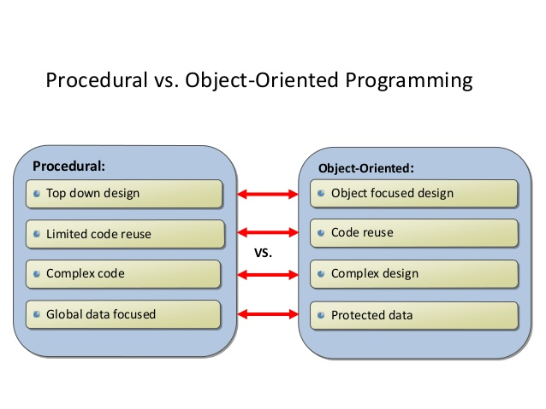

Slide 3
Some Most Important Terms
Good Practices & Coding Conventions
Refactoring & Code smell
Reusable Code

Slide 4
C# Good Practices & Coding Conventions
1.
// Correct int totalProductCount; // Avoid int prodcnt;
2 .
// Correct
public DateTime clientAppointment;
public TimeSpan timeLeft;
// Avoid
public DateTime client_Appointment;
public TimeSpan time_Left;
// Exception
private DateTime _registrationDate;
//
use camelCasing for local variables and method arguments ,
use PascalCasing for class names and method names.
public class UserLog
{
public void Add (Item item)
{
int itemCount = item.Name.Count;
}
}
To Learn More : https://www.dofactory.com/reference/csharp-coding-standards

Slide 5
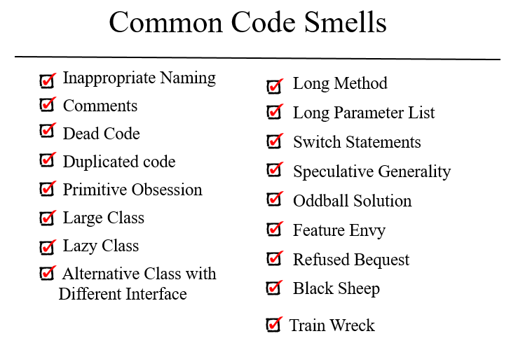

Slide 6
Abstraction & Polymorphism
Abstraction is a process of hiding the implementation details from the user, only the functionality will be provided to the user.
Building complex system by splitting the complexity level by level
Example ,
AddToCart(product);
Public void AddToCart(Product product)
{
// Too Tough Implementation
}
Polymorphism provides the ability to a class to have multiple implementations with the same name.
Method overloading is Compile time Polymorphism .
Example – void Count(int a);
void Count(double a);
void Count(Product product);

Slide 7
Client Requirements
1. I Need a Scorecard System that will Auto calculate score.
2. I will press just one time and score should be calculated.
3. Must Have to show in following format
Commentry : WOW !!! What a Six !! It's Maximum
Run : 20
Wicket : 0
Over : 2.3 Overs
Total Score : 20/0 2.3 Overs

Slide 8
So Let’s Move onto the Code

